Slide 1
CSI4999 - Project 6
Rec Center Management
Sprint 4 Presentation
By: Eapen James, Noah Giles, Aaron Goodfellow, Tyler Streu, Taylor Piot, Doris Gjata, Eric Myllyoja

Slide 2
Sprint 4’s User Stories We focused on
1. As a user, I can reserve a room
2. As an Admin, I can see available equipment
3. As an administrator, I can assign equipment to a room
Notes:
Eapen

Slide 3
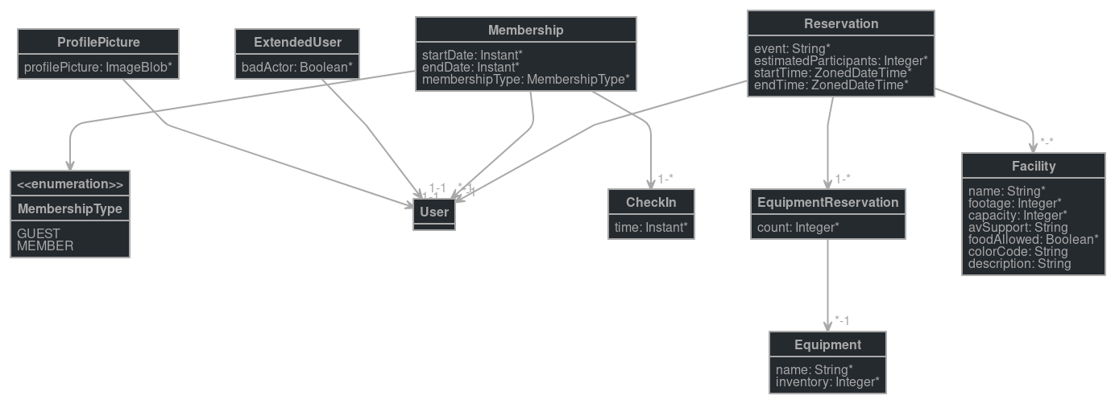
Entity Diagram
Notes:
Noah

Slide 4
QA Testing
User can view calendar
User can reserve a room
User can view available equipment
User can navigate through website pages
Notes:
Eric

Slide 5
Risks and Challenges
Frontend and UI implementation
Team wanted to completely redesigned the UI
A few of the team member began a rewrite of the UI code in a separate repository
Communicating and sharing code between two
Integrating the calendar UI with the program’s state (Redux) and the Hibernate backend database
Notes:
Doris

Slide 6
DEMO
Notes:
Aaron

Slide 7
Next Sprint Objectives
Stories:
As a user, I can reserve equipment.
As a user, I can select room setup.
As a user, I can view all the pages available at the Rec Center.
What that entails:
Equipment Entities Talking about how equipment and rooms go together
Notes:
Tyler

